Slide 1
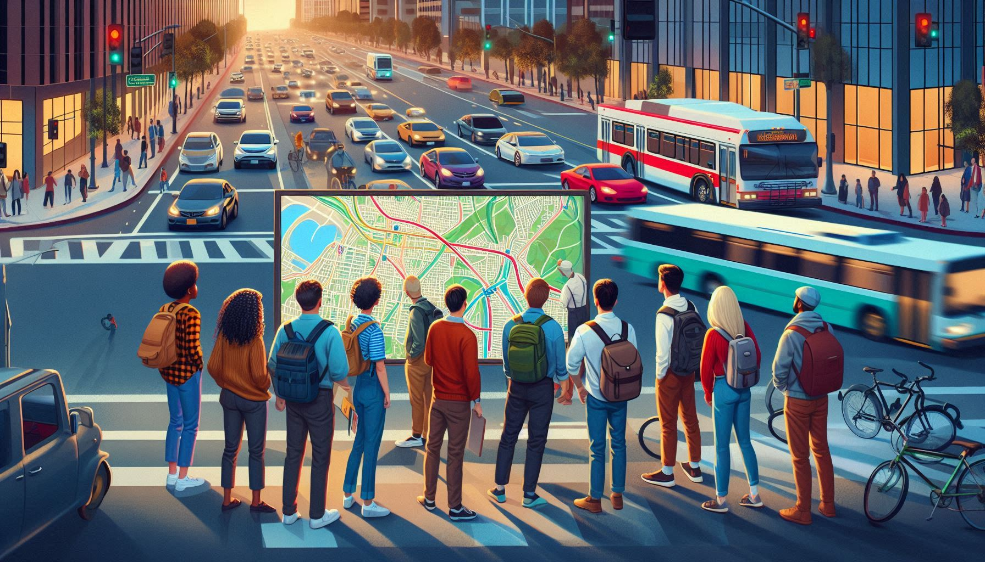
California’s traffic volume analytics

Slide 2
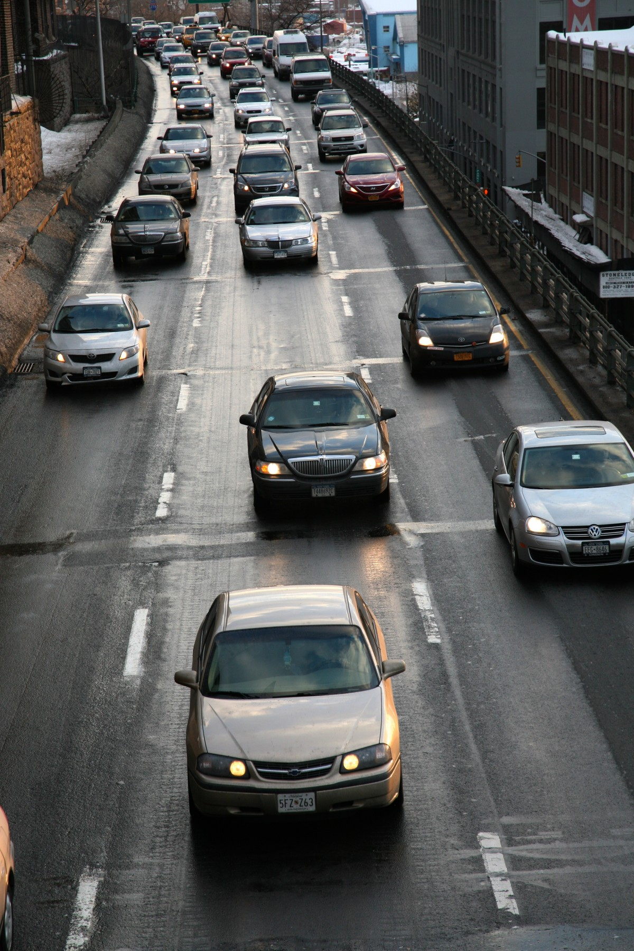
About California’s traffic volume
California’s traffic volume is substantial, with over 31 million registered vehicles traveling more than 32,000 million miles annually1. The state uses Annual Average Daily Traffic (AADT) to measure traffic, which is the total volume for the year divided by 365 days2. Traffic volumes are highest in urban areas, particularly during peak hours2. Caltrans provides detailed traffic counts for state highways, helping in planning and designing infrastructure2. Significant volume changes are tracked along routes to manage congestion and improve safety.

Slide 3
OBJECTIVE
Conduct an in-depth analysis of traffic patterns and trends in California.
Assess the impact of traffic patterns on road safety and identify accident hotspots.
Provide actionable insights for infrastructure planning and develop traffic management strategies.
Assist policymakers in creating data-driven policies.
Foster community engagement by sharing findings and encouraging public participation in traffic safety initiatives.

Slide 4
Key Factors Influencing Traffic Patterns
“Year/Month”
We’ll analyze traffic patterns across different dates to identify any significant trends or anomalies.”
“Day/Time”
Examining traffic flow by day and hour will help us understand peak and off-peak periods.
“Weather”
We’ll consider the impact of holidays on traffic volume and congestion levels.
“Holidays”
Assessing traffic conditions under various weather types will reveal how weather influences traffic behavior.

Slide 5
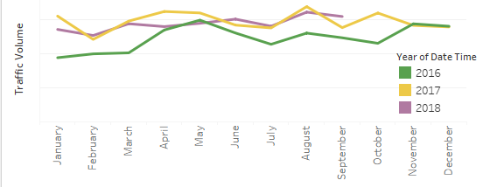
KEY INSIGHTS
2015: Significant peak in October, likely due to a seasonal event or change in traffic patterns.
2017: Notable peak in March, suggesting a high traffic event or change during that period.
2018: Consistent increase in traffic volume, surpassing other years mid-year and maintaining higher volumes, indicating overall growth.
Traffic Volume by Date(Year/Month)
Urban Planning: The data can help in planning infrastructure improvements to accommodate peak traffic periods.
Business Logistics: Businesses can use this data to optimize delivery schedules and manage supply chains more effectively during high traffic months.
Event Planning: Identifying peak traffic months can aid in planning events to either avoid congestion or capitalize on high traffic periods.

Slide 6
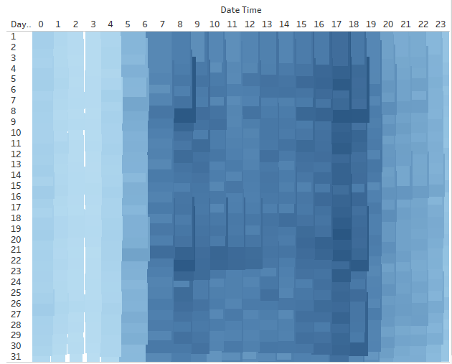
KEY INSIGHTS
Peak Traffic Times: Higher traffic volumes are observed between 7 AM and 7 PM across most days, indicating rush hours.
Low Traffic Times: Late Night to Early Morning: Traffic volume is significantly lower from midnight to around 5 AM, suggesting minimal traffic during these hours.
Moderate traffic times :Between 7 PM and 12AM indicating normal traffic
Traffic Volume by Date(Day/Hour)
Urban Planning: The data can be used to improve road infrastructure and traffic signal timings to better manage peak traffic periods.
Public Transportation: Adjusting public transportation schedules to align with peak traffic times can enhance efficiency and reduce congestion.
Business Operations: Businesses can optimize delivery and service schedules based on traffic patterns to ensure timely operations.

Slide 7
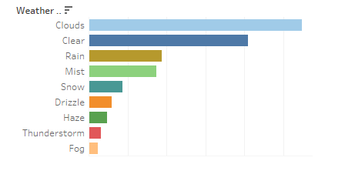
KEY INSIGHTS
Clear Weather: Highest traffic volume, indicating more people are on the roads, Clear weather encourages higher traffic
Clouds and Rain: Moderate traffic volume, suggesting these conditions don’t deter traffic significantly but don’t encourage it as much as clear weather, : volumes, while severe weather conditions like snow and fog significantly reduce traffic.
Mist, Haze, and Drizzle: Lower traffic volume due to reduced visibility and potentially hazardous driving conditions.
Snow, Thunderstorm, and Fog: Lowest traffic volume, likely due to safety concerns and reduced visibility.
Traffic Volume by Weather type
Urban Planning: The data can help in planning infrastructure improvements to accommodate peak traffic periods.
Business Logistics: Businesses can use this data to optimize delivery schedules and manage supply chains more effectively during high traffic months.
Event Planning: Identifying peak traffic months can aid in planning events to either avoid congestion or capitalize on high traffic periods.

Slide 8
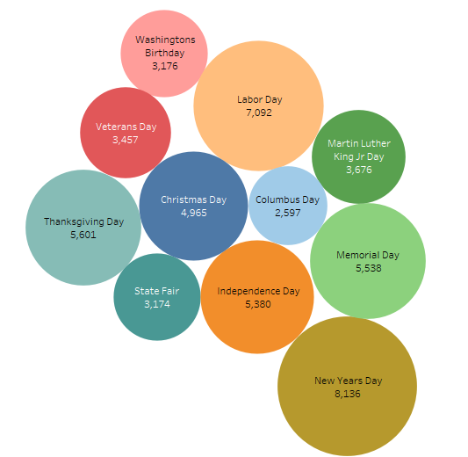
Traffic Volume by holidays in US
KEY INSIGHTS
New Year’s Day: Highest traffic volume, indicating significant travel or activities.
Labor Day: Second highest traffic volume, suggesting many people travel or engage in activities.
Thanksgiving Day, Memorial Day, Christmas Day, and Independence Day: Moderate to high traffic volumes, reflecting family gatherings and travel traditions.
Other Holidays: Lower traffic volumes compared to major holidays, including Columbus Day, Martin Luther King Jr. Day, Veterans Day, and Washington’s Birthday.
Holiday Travel Patterns: Major holidays like New Year’s Day, Labor Day, Thanksgiving, and Memorial Day see significant increases in traffic volume due to travel and celebrations.
Seasonal Variations: Traffic volumes vary significantly across different holidays, reflecting seasonal travel patterns and holiday-specific activities.
Urban Planning: The data can help in planning infrastructure improvements to accommodate peak traffic periods.
Business Logistics: Businesses can use this data to optimize delivery schedules and manage supply chains more effectively during high traffic months.
Event Planning: Identifying peak traffic months can aid in planning events to either avoid congestion or capitalize on high traffic periods.

Slide 9
Recommendations
Infrastructure Improvements: Data can help plan and improve road infrastructure and traffic signal timings to manage peak traffic periods.
Business Optimization: Businesses can use the data to optimize delivery schedules and manage supply chains during high traffic months.
Event Planning: Identifying peak traffic months can aid in planning events to avoid congestion or capitalize on high traffic periods.
Public Transportation: Adjusting public transportation schedules to align with peak traffic times can enhance efficiency and reduce congestion.

Slide 10

Thank You
I hope this presentation was successful in providing valuable insights. Your feedback is greatly appreciated, and I welcome any recommendations to improve my presentation skills. Thank you for taking the time to read through this presentation.
Mahmoud Abou Elfadl

